Slide 1
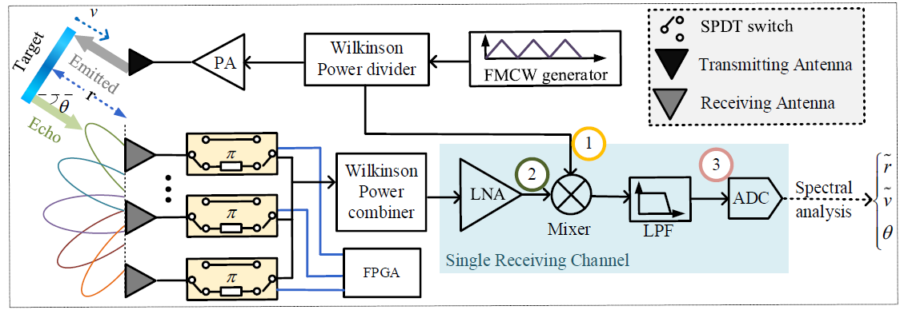
Honours Project: FMCW Radar System for Material Detection
Experiment platform
Background:
FMCW radar is widely used for wireless sensing systems
Current FMCW radar system can only detect the distance, speed, etc. It lacks capabilities to detect the material properties, e.g., the dielectric constant
Project Goals:
Design and validate a FMCW system to clarify different material properties
Enable repeatable, high-precision measurement in a lab environment
Project Requirements:
Capabilities Required:
Interested in wireless technologies
Capable of independent research
Basic knowledge in electromagnetic waves and wireless signals
Teamwork collaboration
Deliverables & Milestones:
Latest literature review on FMCW radar detection systems
Setup the experimental platform
System testing and verification
Project report
Communications & Progress:
Online weekly meeting;
Performance will be assessed based on each week’s progress.

